Slide 1
DevOpsing in a Microsoft World

Slide 2
DevOps Challenges
Normal, rational hesitation
Functional silos, organizational alignment
Typical ALDO challenges
Monolithic tools, screenshots, click next
Closed source, undocumented APIs, friction
Reliance on vendors for engineering
COTS (Buy vs. Build)
Virtualization Complacency
Limited engineering tradition
Typical
IT
Org
Typical Microsoft
Org
Columbia
Notes:
Excited because ChatOps is transformative.

Slide 3
Core Challenge: DevOps transformation requires a learning organization

Slide 4
Options
Build a learning organization
Hire DevOps engineers
CxO DevOps initiative
Small batch DevOps ←→ Learning Organization
Notes:
Excited because ChatOps is transformative.

Slide 5
SWOT Analysis
Strengths Vendor partnerships Exceptionally tight knit teams Substantial expertise in virtualization, storage Strong operational background Entrepreneurial DNA Low turnover in team (loyalty) | Weaknesses Reliance on vendors (COTS, Microsoft) Single threaded in a number of technologies Substantial legacy footprint Large population of long-lived servers Organization not “product” oriented Decentralized Internal Customer base
Opportunities Centralized Infrastructure Engineering 2 Engineers with scripting capabilities | Threats
Notes:
Excited because ChatOps is transformative.

Slide 6
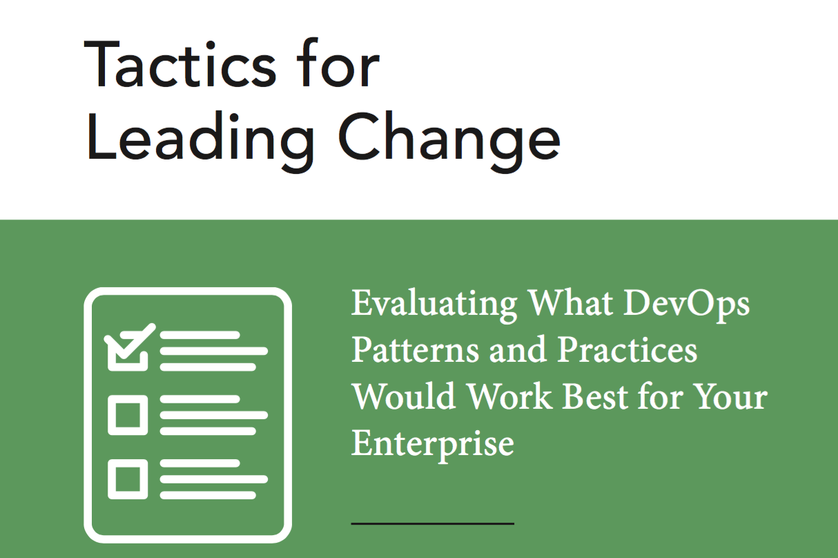
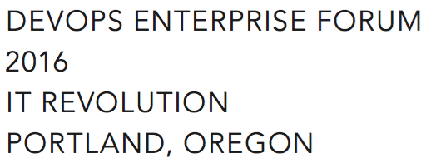
Small batch DevOps®
Make a compelling case for change (Tactic 14)
DevOps information sessions (Tactic 2)
Make Work Visible (Tactic 11) – TFS Kanban
Experiments (Tactic 4) – vRA for IaaS
Gemba Walks (Tactic 9)
Later
Set WIP Limits (Tactic 13)
Blameless Retrospectives (Tactic 5)
Notes:
Excited because ChatOps is transformative.

Slide 7
2015
Q1 Daily Standup → Weekly Standup TFS Kanban TFS Version Control : Goal 250 artifacts Conferences – spread wealth DevOps in a Microsoft World (Snover) Primary / Alternate engineer swaps | Q2 CHEF Conf 2015 x 10 Phoenix Project suggested reading Nordstrom reference calls PowerShell to call vCAC Prepare Workspace (TFS, .Net, PS, ChefDk) CHEF POC
Q3 Enterprise CHEF contract (700 nodes) Automacon Weekly Demos DSC Server provisioning (PoshOrigin) Difficulty stabilizing tools, automation Height of frustration | Q4 Simplified PoshOrigin: WSIWYG PowerShell onsite training CHEF Greenfield via Server provisioning Automation for ransomware remediation Curious people series Desktop PowerShell module CHEF: 100+ Greenfield Servers 500+ artifacts in version control
Notes:
Excited because ChatOps is transformative.

Slide 8
2016
Q1 Greenfield N-Tier App with CHEF CHEF onsite training Slack experimentation Work visibility & analytics – TFS + PowerShell Clean up ticketing system vRA, NSX, etc. investigation All in one monitoring solution | Q2 Stretched vSAN cluster Private Data Center migration via automation PowerShell utilities to manage TFS board Exploration: PowerShell script consumption Automation: psake, pester, Artifactory DevOpsDays Portland Sponsor CFPs for tech conferences
Q3 Velocity Conf - ChatOps & Rotations Team of Teams – General Stan McChrystal Org: Cross functional re-org SCM: GitLab – version control, piplines ChatOps: Hubot + Slack + GitLab (CI/CD) O365 – Exchange in the Cloud | Q4 Exploration: EMC scripting, AWS/Azure, Pods Challenge: NetScaler pains, SOX 404 CHEF: 500+ Servers & CHEF Automate ChatOps: 150+ commands, “Etsy Day 1”, demos Friction: Prioritization, Principles Org: Hiring great engineer, rotations
Notes:
Excited because ChatOps is transformative.

Slide 9
2017
Organization
Weekly retrospectives – ITSM Queue, Notable incidents/projects
Cross-functional teams of 4 to 5 that rotate
ChatOps
Contributions from other orgs & “We should create a RYU for that”
Slack Rules of Engagement (Skype For Business, Workplace, etc.)
Azure Management & Costing, NetScaler, SharePoint, Teradata, Commvault, VMAX migrations
Demo with Microsoft Teams Product team
Azure Exploration
10 Proofs of Concept in flight, GitLab CI (Terraform/ARM)
Green/Blue
NetScaler, SAP Application Servers
CHEF
”Brownfield”, 1300+ Servers, Sensu cookbook, Security / Compliance CIS cookbooks
Notes:
Excited because ChatOps is transformative.

Slide 10
In their words:
How would you describe the journey we’ve been own over the last 2 years?
What’s been your favorite aspect of this journey?
What’s been your least favorite aspect of this journey?
What would you tell your “2015 self” about the journey you are about to go on?
What are you most eagerly anticipating over the next 2 years?
If you had unlimited resources and control, what would be the one thing you would change going forward?
Notes:
Excited because ChatOps is transformative.

Slide 11
In their words: “Describe the journey”
It has given me ability to stretch and grow
Rewarding, bumpy, and lots of self doubt, definitely felt like an imposter. Eventually: “I can do things, I can grow”
The path has been both invigorating and frustrating; but the journey has been worth it.
Difficult + stressful: hard balancing DevOps, Maintenance, Support
Team has grown quite a bit but can regress to old ideas and mindsets; Learned quite a bit about dealing with folks I don’t agree with
Hard to ramp up due to the slew of tools, behaviors, and new ways of thinking (especially for windows admins)
Notes:
Excited because ChatOps is transformative.

Slide 12
In their words: “Favorite aspect of journey”
Scripting / automation; making my life easier
Leading edge of enterprise IT. DevOps is not new for unicorns but still in beginning stages in Microsoft centric enterprises
People, Teammates, Mentorship, Learning to ask for help; Developing confidence
ChatOps! It has encouraged more collaboration and automation
I have enjoyed expanding my sphere of responsibilities and interests by breaking down IT silos. The variety and level of activity within the team has been rejuvenating
The encouragement to experiment (fail) without the fear of punishment
Notes:
Excited because ChatOps is transformative.

Slide 13
In their words: “Least favorite part of journey”
Constant change… all the experiments, not enough time to go deep
Adapting to change is difficult, especially for those in the field for many years. Adopting new working styles
Not being able to devote enough time to new work
Feeling lost, discomfort due to width and breadth of required areas; Feeling helpless
Windows makes it harder than it needs to be
Lack of prioritization across projects
Not going faster with transformation
The lack of time to experiment with technologies outside my immediate areas of responsibility has been frustrating
Notes:
Excited because ChatOps is transformative.

Slide 14
In their words: “Advice for 2015 self”
Don’t be afraid to fail; Don’t be afraid to learn from prior mistakes; Jump in and experiment
Be ready, have patience and be open to learning new things
Don’t be overwhelmed by DevOps nirvana…try to stay focused on incremental improvements. Each improvement is like a savings deposit that will compound over time
Your existing skills are becoming obsolete and your expertise is at risk; Find a way to get started on new ideas
Don’t be afraid to ask for help; experts are excited and enthusiastic about helping; Don’t give up
Prepare for a lot of change; be willing to embrace the change; Reflect on why you do things...is it still valid? Was it ever valid?
Notes:
Excited because ChatOps is transformative.

Slide 15
In their words: “What are you anticipating”
Going deeper with CHEF
Applying our practices to the public cloud
Growing new skills, security automation, collaboration
Influening future implementations / buying decisions at Columbia
Migration of Columbia to public could
More transformation; more public cloud
Getting better; Public cloud
Notes:
Excited because ChatOps is transformative.

Slide 17
In their words:
How would you describe the journey we’ve been own over the last 2 years?
What’s been your favorite aspect of this journey?
What’s been your least favorite aspect of this journey?
What would you tell your “2015 self” about the journey you are about to go on?
What are you most eagerly anticipating over the next 2 years?
If you had unlimited resources and control, what would be the one thing you would change going forward?
Notes:
Excited because ChatOps is transformative.

Slide 18
In their words: “Describe the journey”
Scary treading into the unknown
It has given me ability to stretch and grow
Rewarding, bumpy, and lots of self doubt, definitely felt like an imposter. Eventually: “I can do things, I can grow”
The path has been both invigorating and frustrating; but the journey has been work it.
Difficult + stressful: hard balancing DevOps, Maintenance, Support
Team has grown quite a bit but can regress to old ideas and mindsets; Learned quite a bit about dealing with folks I don’t agree with
Hard to ramp up due to the slew of tools, behaviors, and new ways of thinking (especially for windows admins)
Notes:
Excited because ChatOps is transformative.

Slide 19
In their words: “Favorite aspect of journey”
Scripting / automation; making my life easier
Leading edge of enterprise IT. DevOps is not new for unicorns but still in beginning stages in Microsoft centric enterprises
People, Teammates, Mentorship, Learning to ask for help; Developing confidence
ChatOps! It has encouraged more collaboration and automation
I have enjoyed expanding my sphere of responsibilities and interests by breaking down IT silos. The variety and level of activity within the team has been rejuvenating
The encouragement to experiment (fail) without the fear of punishment
Notes:
Excited because ChatOps is transformative.

Slide 20
In their words: “Least favorite part of journey”
Constant change… all the experiments, not enough time to go deep
Adapting to change is difficult, especially for those in the field for many years. Adopting new working styles
Not being able to devote enough time to new work
Feeling lost, discomfort due to width and breadth of required areas; Feeling helpless
Windows makes it harder than it needs to be
Lack of prioritization across projects
Not going faster with transformation
The lack of time to experiment with technologies outside my immediate areas of responsibility has been frustrating
Notes:
Excited because ChatOps is transformative.

Slide 21
In their words: “Advice for 2015 self”
Don’t be afraid to fail; Don’t be afraid to learn from prior mistakes; Jump in and experiment
Be ready, have patience and be open to learning new things
Don’t be overwhelmed by DevOps nirvana…try to stay focused on incremental improvements. Each improvement is like a savings deposit that will compound over time
Your existing skills are becoming obsolete and your expertise is at risk; Find a way to get started on new ideas
Don’t be afraid to ask for help; experts are excited and enthusiastic about helping; Don’t give up
Prepare for a lot of change; be willing to embrace the change; Reflect on why you do things...is it still valid? Was it ever valid?
Notes:
Excited because ChatOps is transformative.

Slide 22
In their words: “What are you anticipating”
Going deeper with CHEF
Applying our practices to the public cloud
Growing new skills, security automation, collaboration
Influening future implementations / buying decisions at Columbia
Migration of Columbia to public could
More transformation; more public cloud
Getting better; Public cloud
Notes:
Excited because ChatOps is transformative.

